Slide 1
Hawaiʻi Conservation Conference 2015
and the
Kīpaepae Kā Mauli Kuauli (Opening Ceremony)
Monday, August 3rd, 2015
Orientations BEGIN AT 4:00 pm, Kīpaepae BEGINS AT 5:00 pm
University of Hawaiʻi at Hilo - Gymnasium

Slide 2
Making Kīhei for
Kīpaepae Kā Mauli Kuauli
Workshops and resources are currently being coordinated on each island to help prepare conference participants for the Kīpaepae Kā Mauli Kuauli.
The following slides provide some basic information about making kīhei...

Slide 3
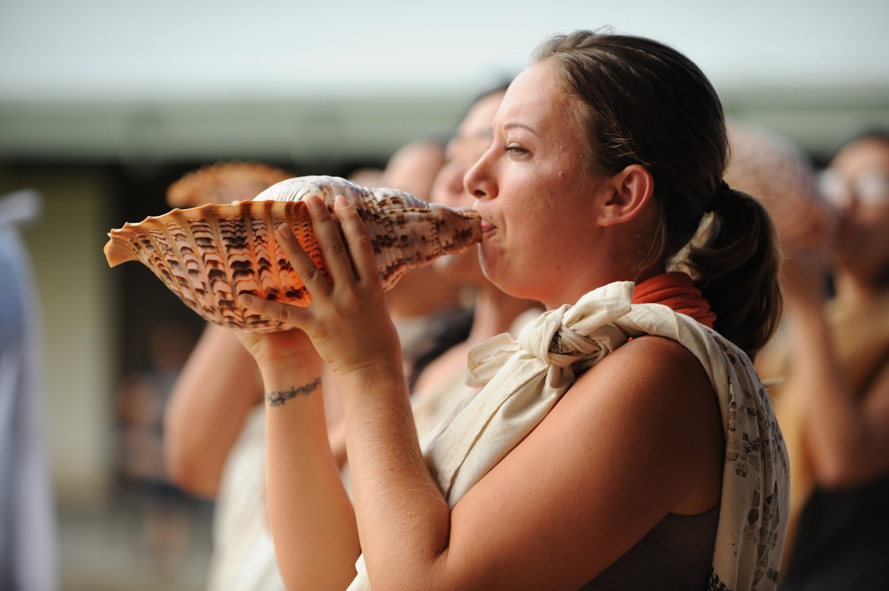
What is a kīhei?
Notes:
Transition slide...add picture

Slide 4
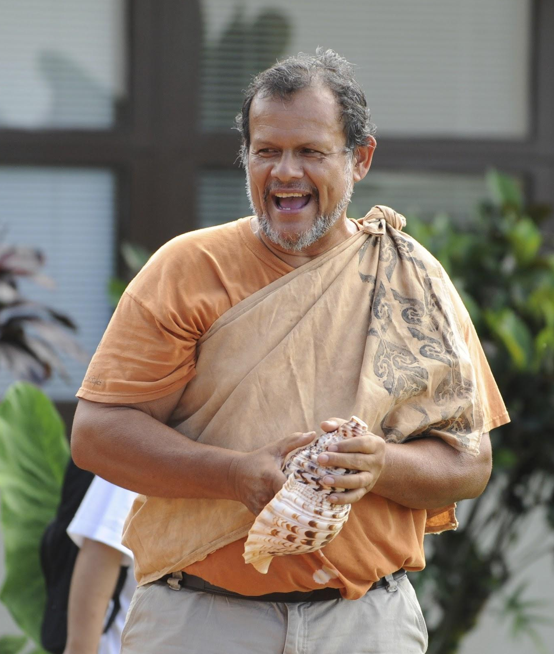
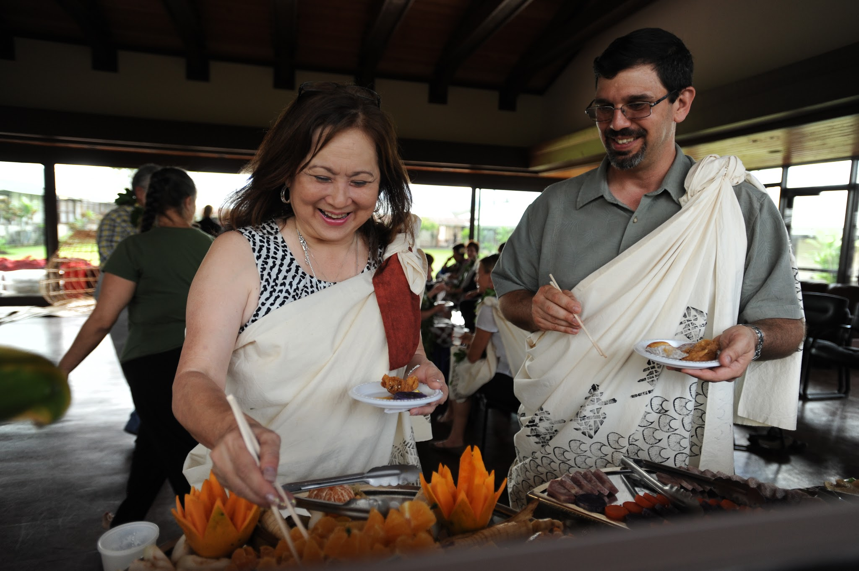
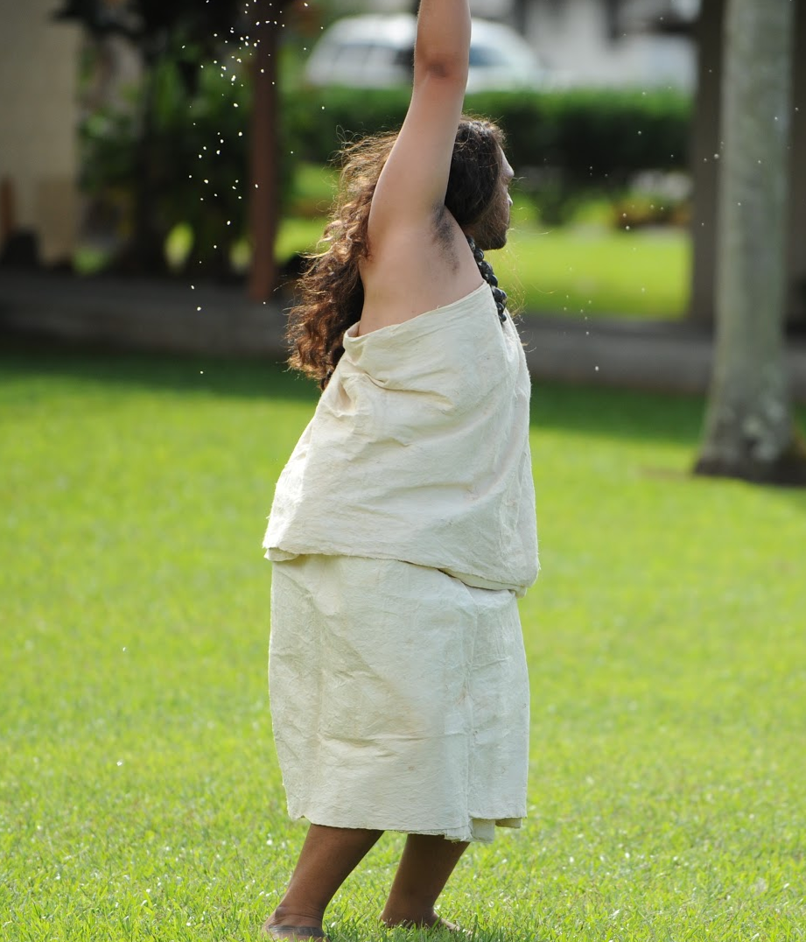
What is a kīhei?
Hawaiian Dictionary (Pukui & Elbert) Definition:
Shawl, cape, afghan; cloak of makaloa matting; rectangular tapa garment worn over one shoulder and tied in a knot; bed covering; to wear a kīhei.

Slide 5
What is a kīhei?
ʻŌlelo Hawaiʻi : The language itself provides insight to Hawaiian pedagogy, thought processes, and environmental kinship.
kī | an intensifying prefix
hei | to ensnare
During an event in which kīhei are worn, we look to “ensnare” & provide direction for the focus, energy and intent of the the group in that moment.

Slide 6
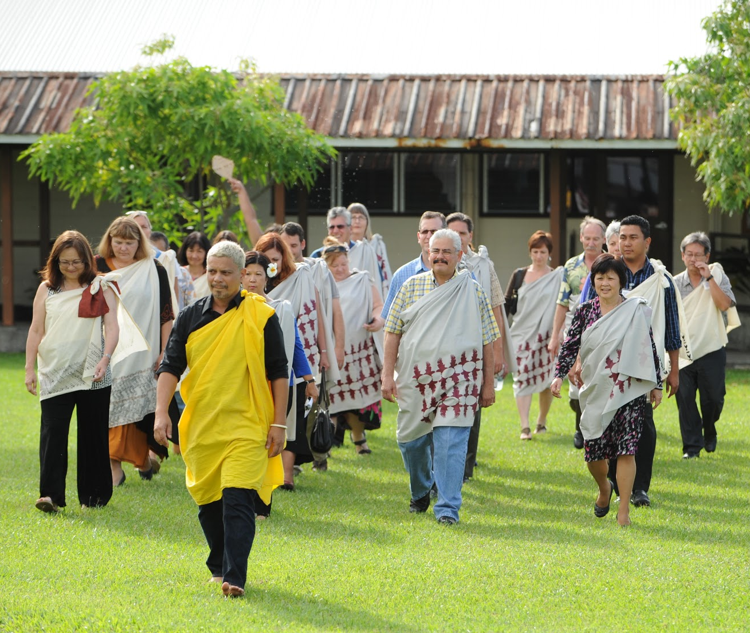
What is a kīhei?
For the Kīpaepae Kā Mauli Kuauli the kīhei will be used as a traditional ceremonial garment to cover the upper body.

Slide 7
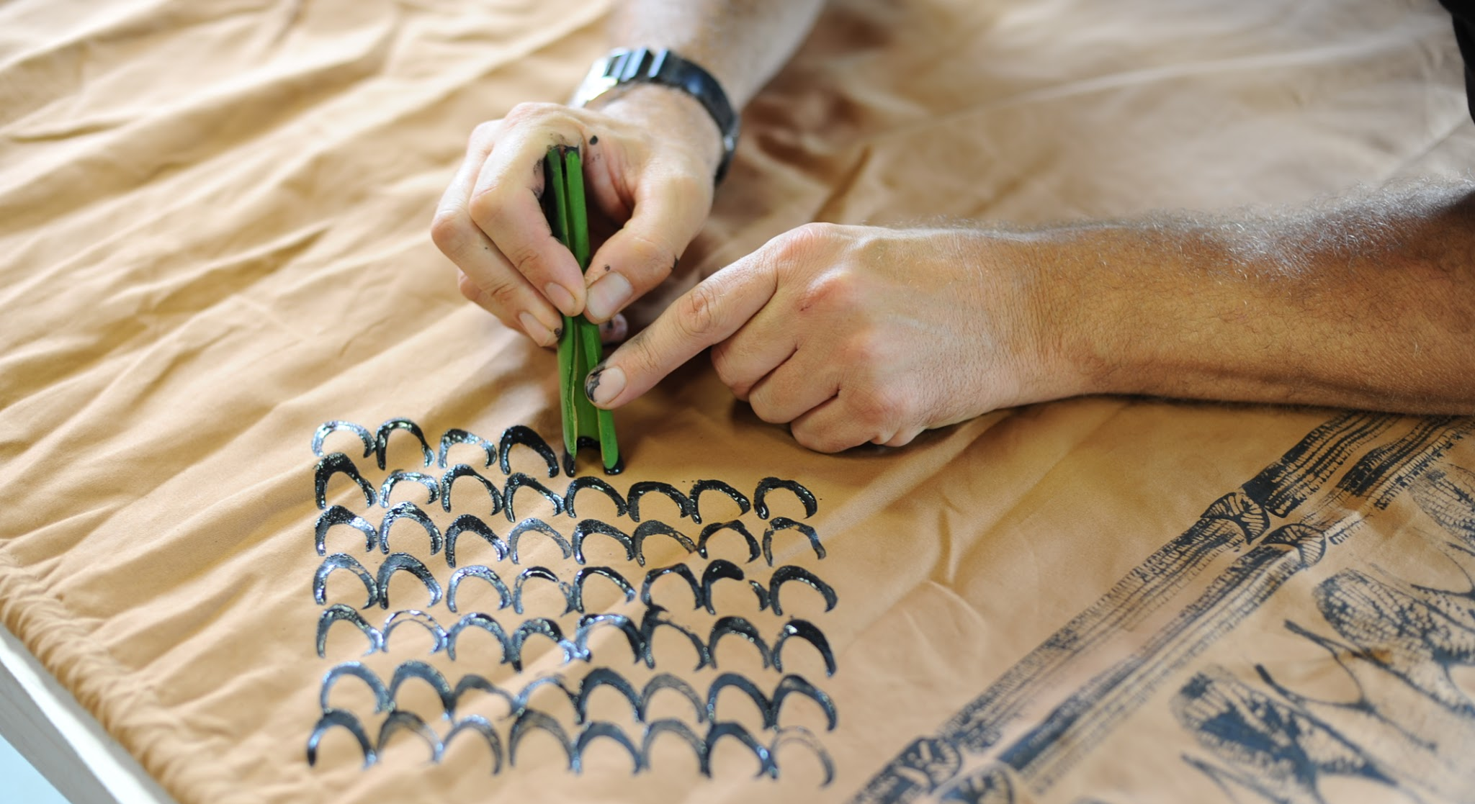
Things to consider when making your kīhei...

Slide 8
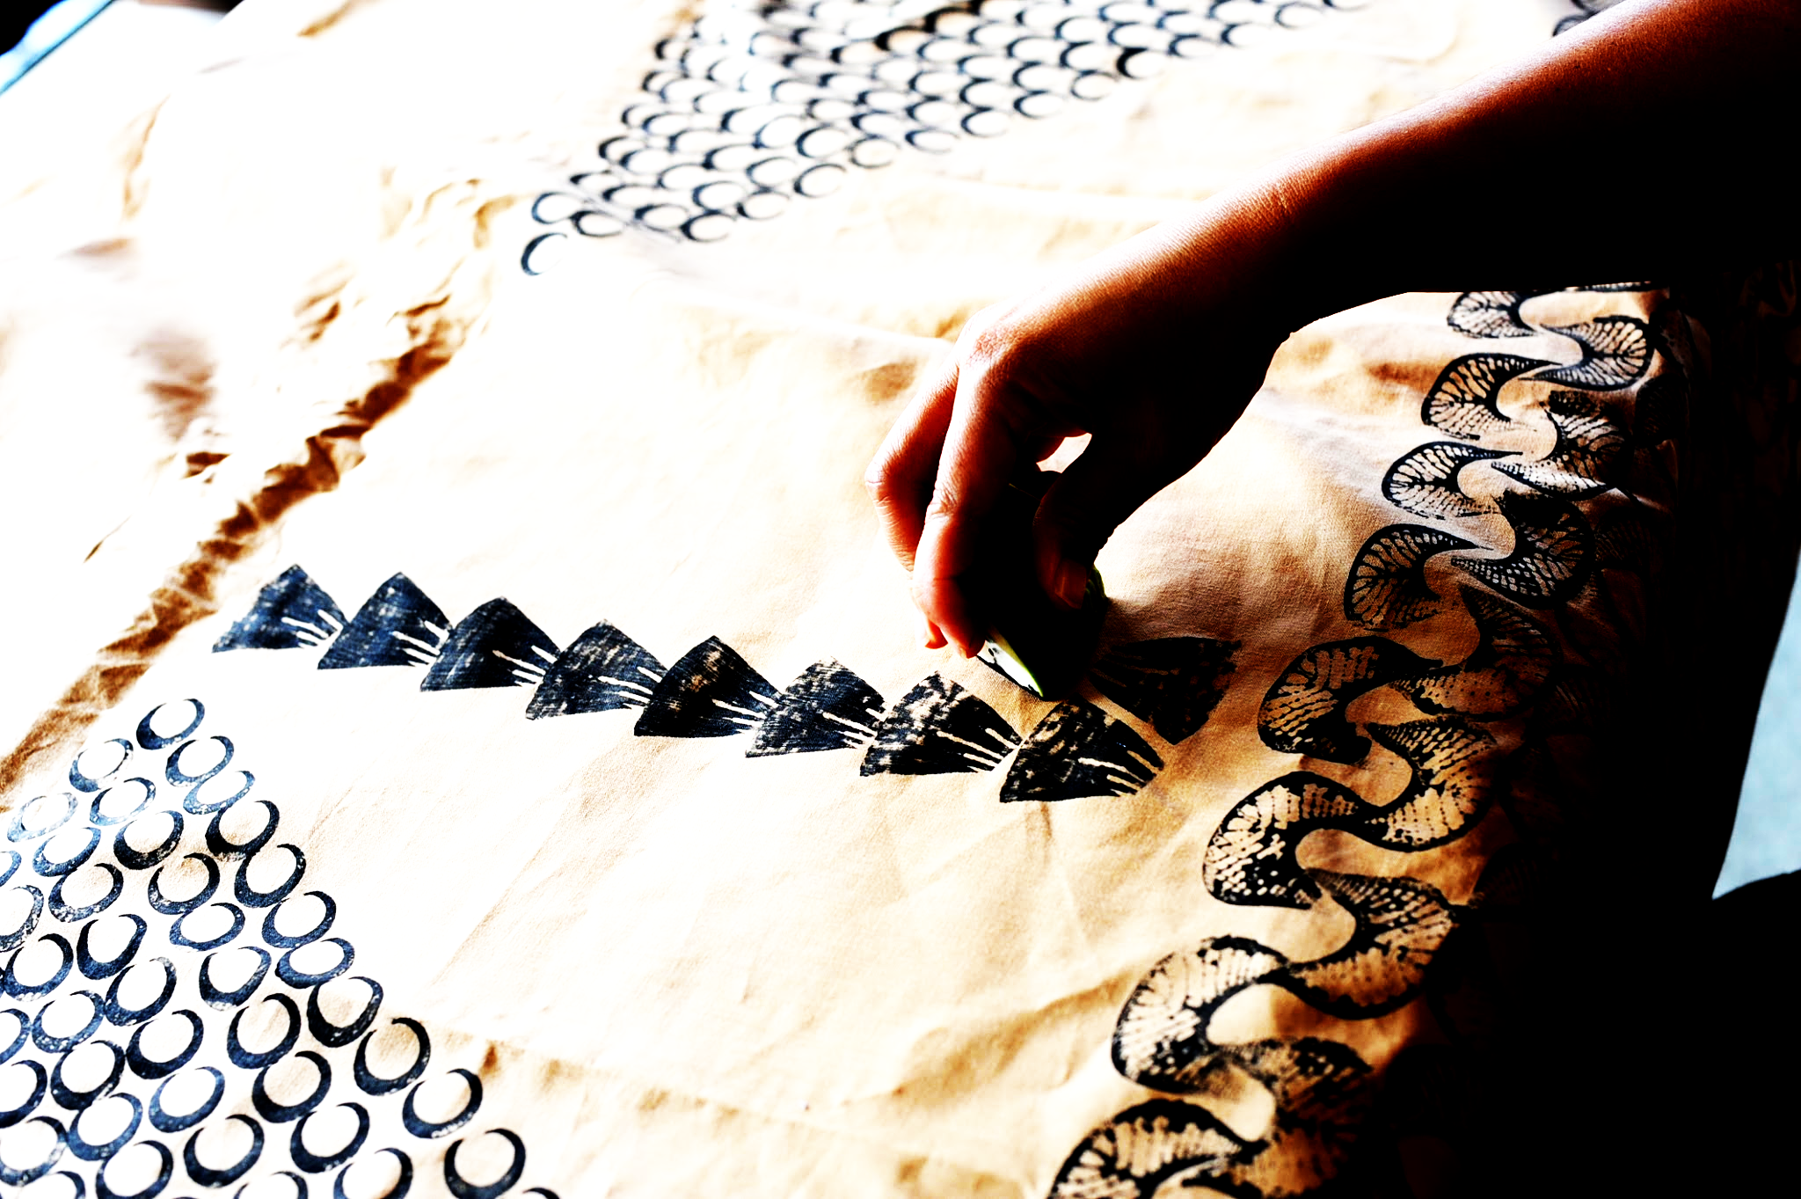
Components of a kīhei
There are many different styles and types of materials that can be used to make kīhei. The style and materials used will depend on the purpose and meanings that one is portraying through their kīhei.
Traditional Resources | Modern Resources
Kapa | Muslin
Natural Dyes | Synthetic Dyes
Natural Paints | Acrylic Paints

Slide 9
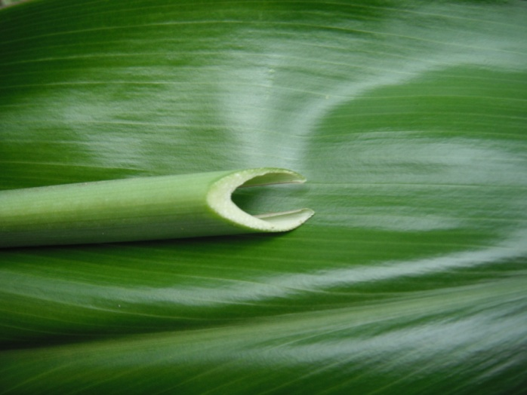
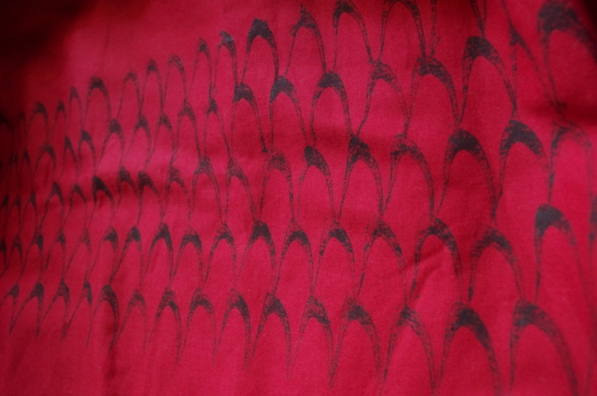
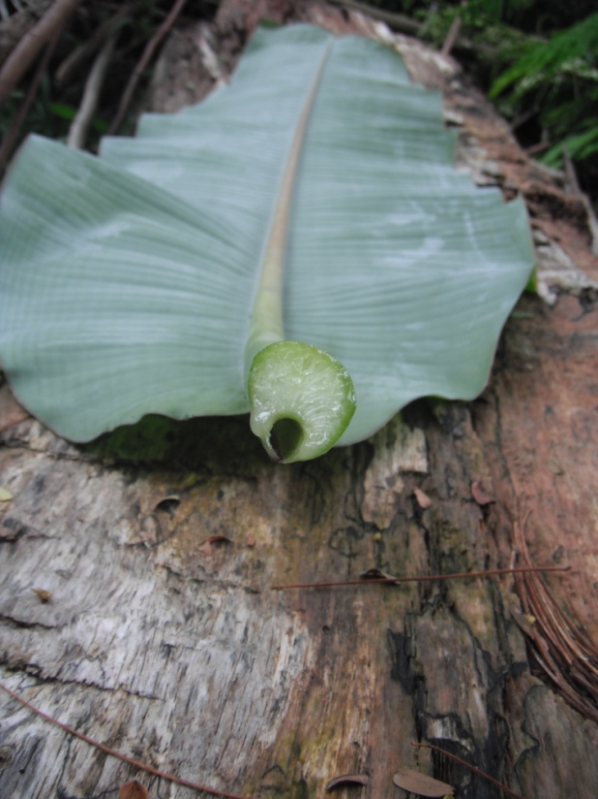
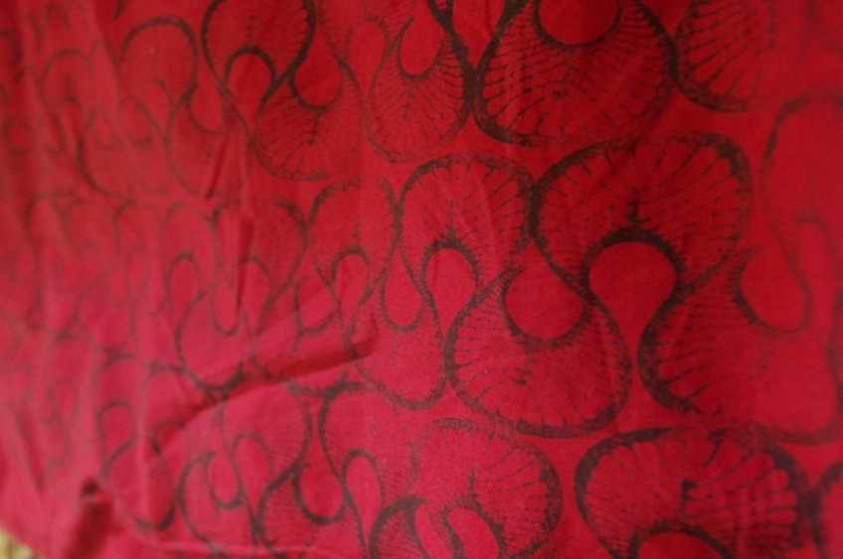
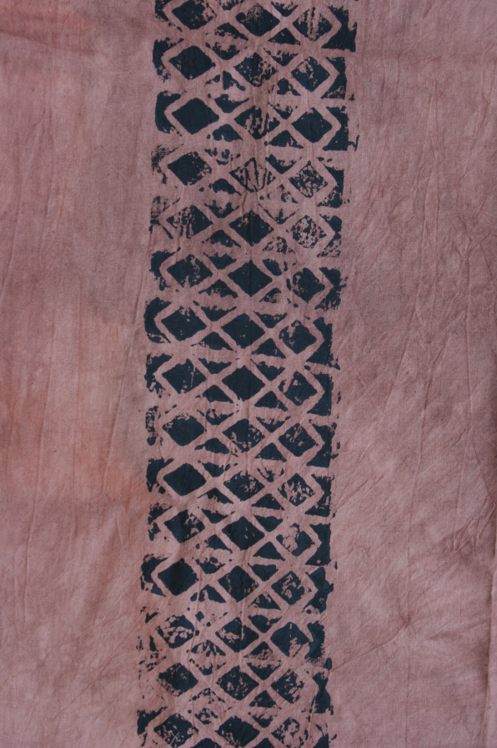
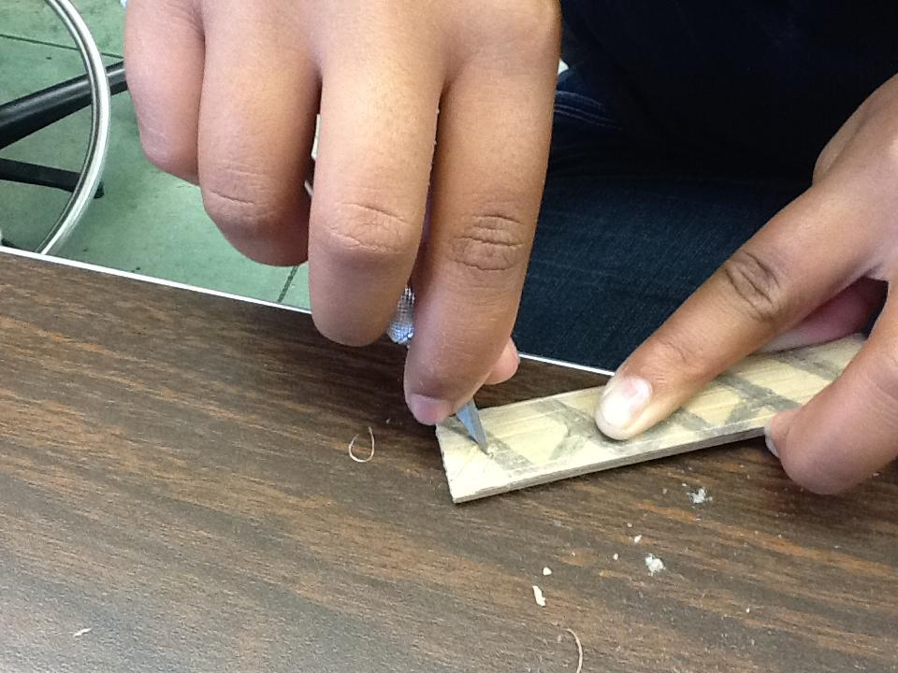
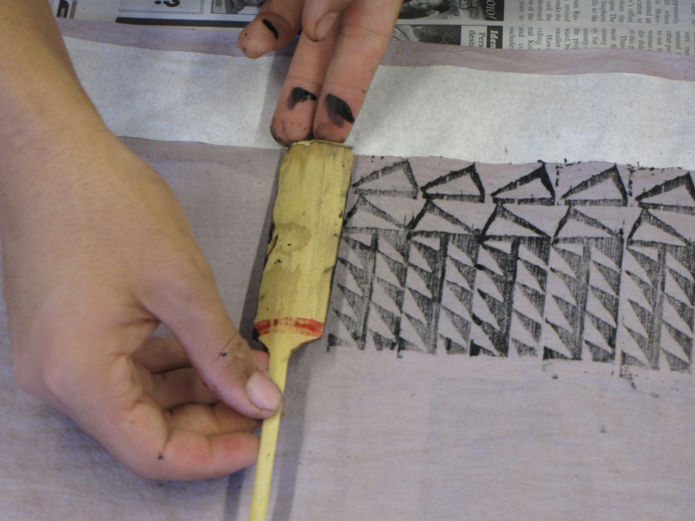
Kāpala: Stamping your kīhei
Kāpala, or stamping, is used to communicate one’s personal or familial connection to the environment.
Kāpala can be made from a variety of things, such as carving a design into a piece of bamboo (ʻohe kāpala) or using the stem of a banana or ti leaf to create a design (lau kāpala).

Slide 10
Kāpala: Stamping your kīhei
We encourage all participants to enhance their kīhei with a kāpala.
Each plant and design included should carry intent and connection for you.
Perhaps have the conversation with you organization to weave a common theme for your group. This process should help to demonstrate a common foundation for all of you involved.

Slide 11
Making your kīhei
Below are some basic and simple guidelines to making kīhei with modern materials:
Maintain a positive mindset & intention throughout
Muslin or natural colored fabric can be used
2-yards in length is recommended
Full or half width (personal preference)
Hem all raw edges of the material
Kāpala (print) with acrylic paint
Heat set your print when finished

Slide 12
Making your kīhei
Your organization and community is filled with information and cultural resources.
We encourage you to ask and begin this dialogue with those people you know and invite them to share their process with your group.
Utilize the resources in your environment wisely;
our verdant landscapes serve a function not only to the environment but also to the relationships we create within them.

Slide 13
See you in
Hilo, Hawaiʻi at the
Kīpaepae Kā Mauli Kuauli!

