Slide 1
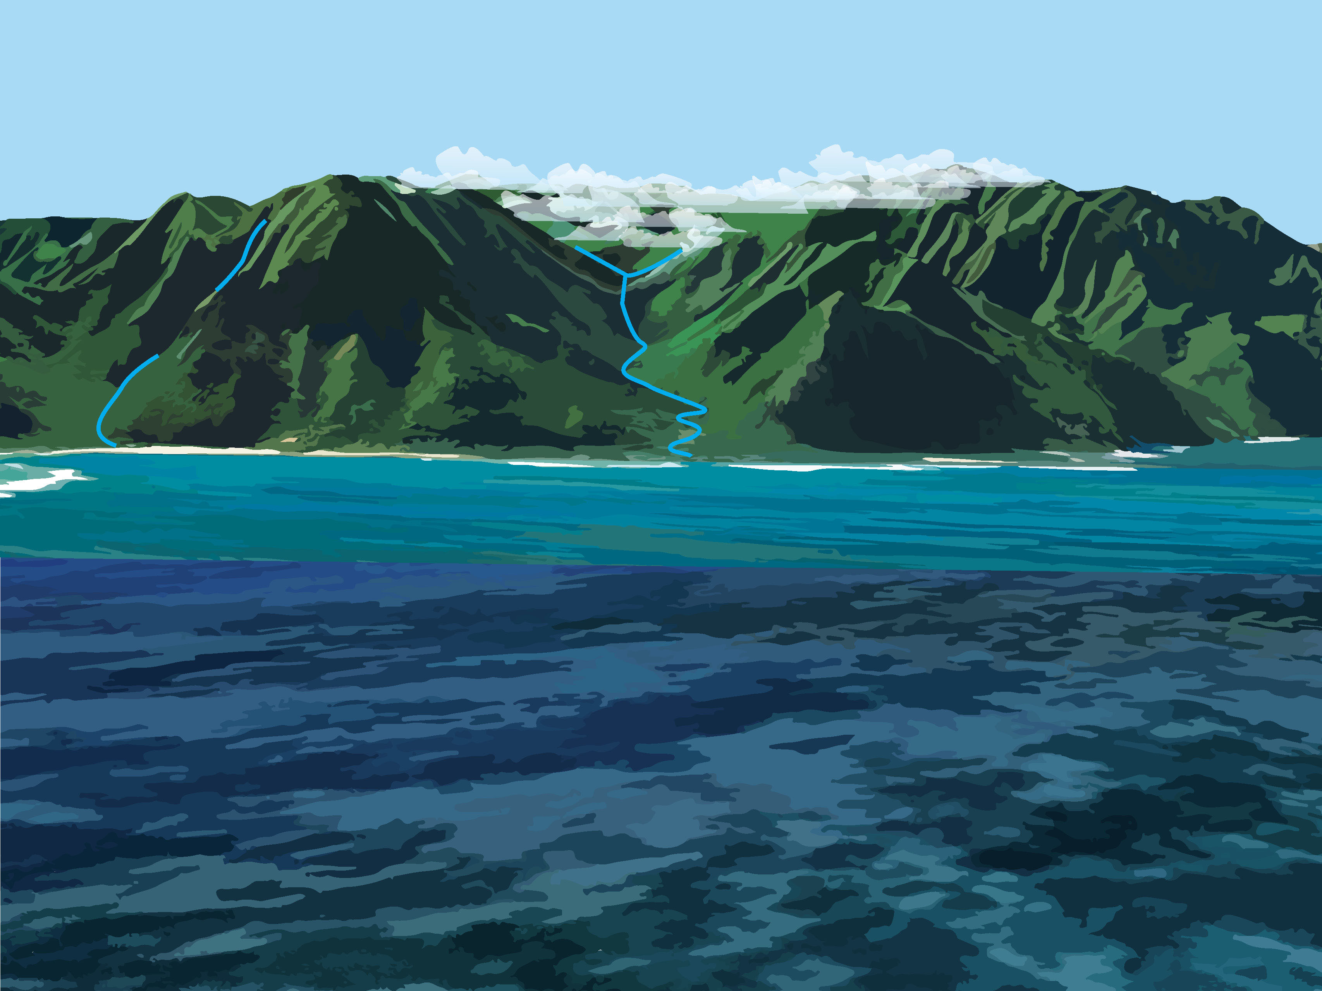
TITLE HERE

Slide 2
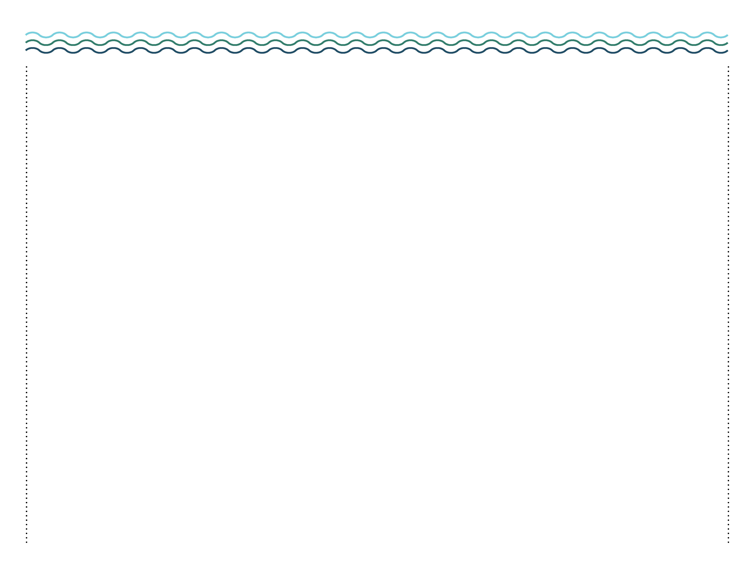
A STATUS REPORT ON RIDGE TO REEF HEALTH
Notes:
A Status Report on Ridge to Reef Health – Place image of poster here

Slide 3
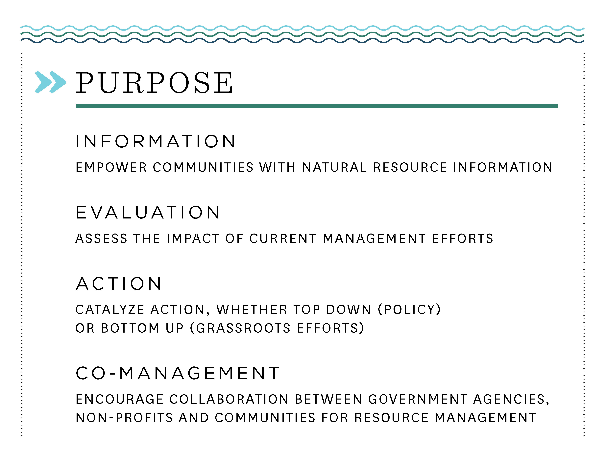

Slide 4
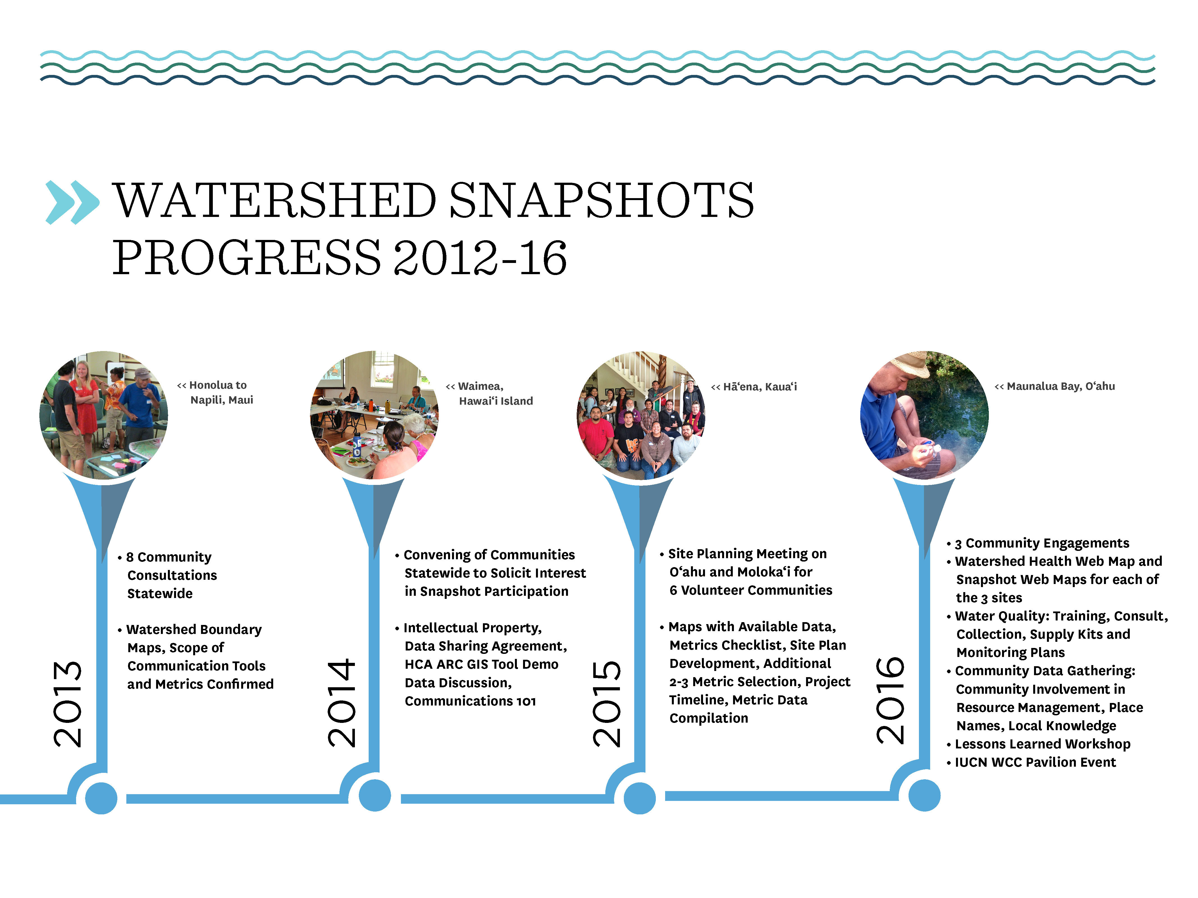
Notes:
In consultation with the Hawai’i Conservation Alliance, 8 communities across the State identified metrics that would best define the health of their area, including socio-economic and cultural variables. In 2016, available data from researchers and resource management organizations were compiled to inform the selected metrics. Results are housed as a public resource in an online library of all related watershed-related data, and can be found at hca.maps.arcgis.com. HCA and 3 communities work together to analyze, compile and design information for a suite of communication tools to help inform, guide, and garner support for more effective mauka-to-makai management efforts. Visit www.hawaiiconservation.org/communitysnapshot for more information.

Slide 5
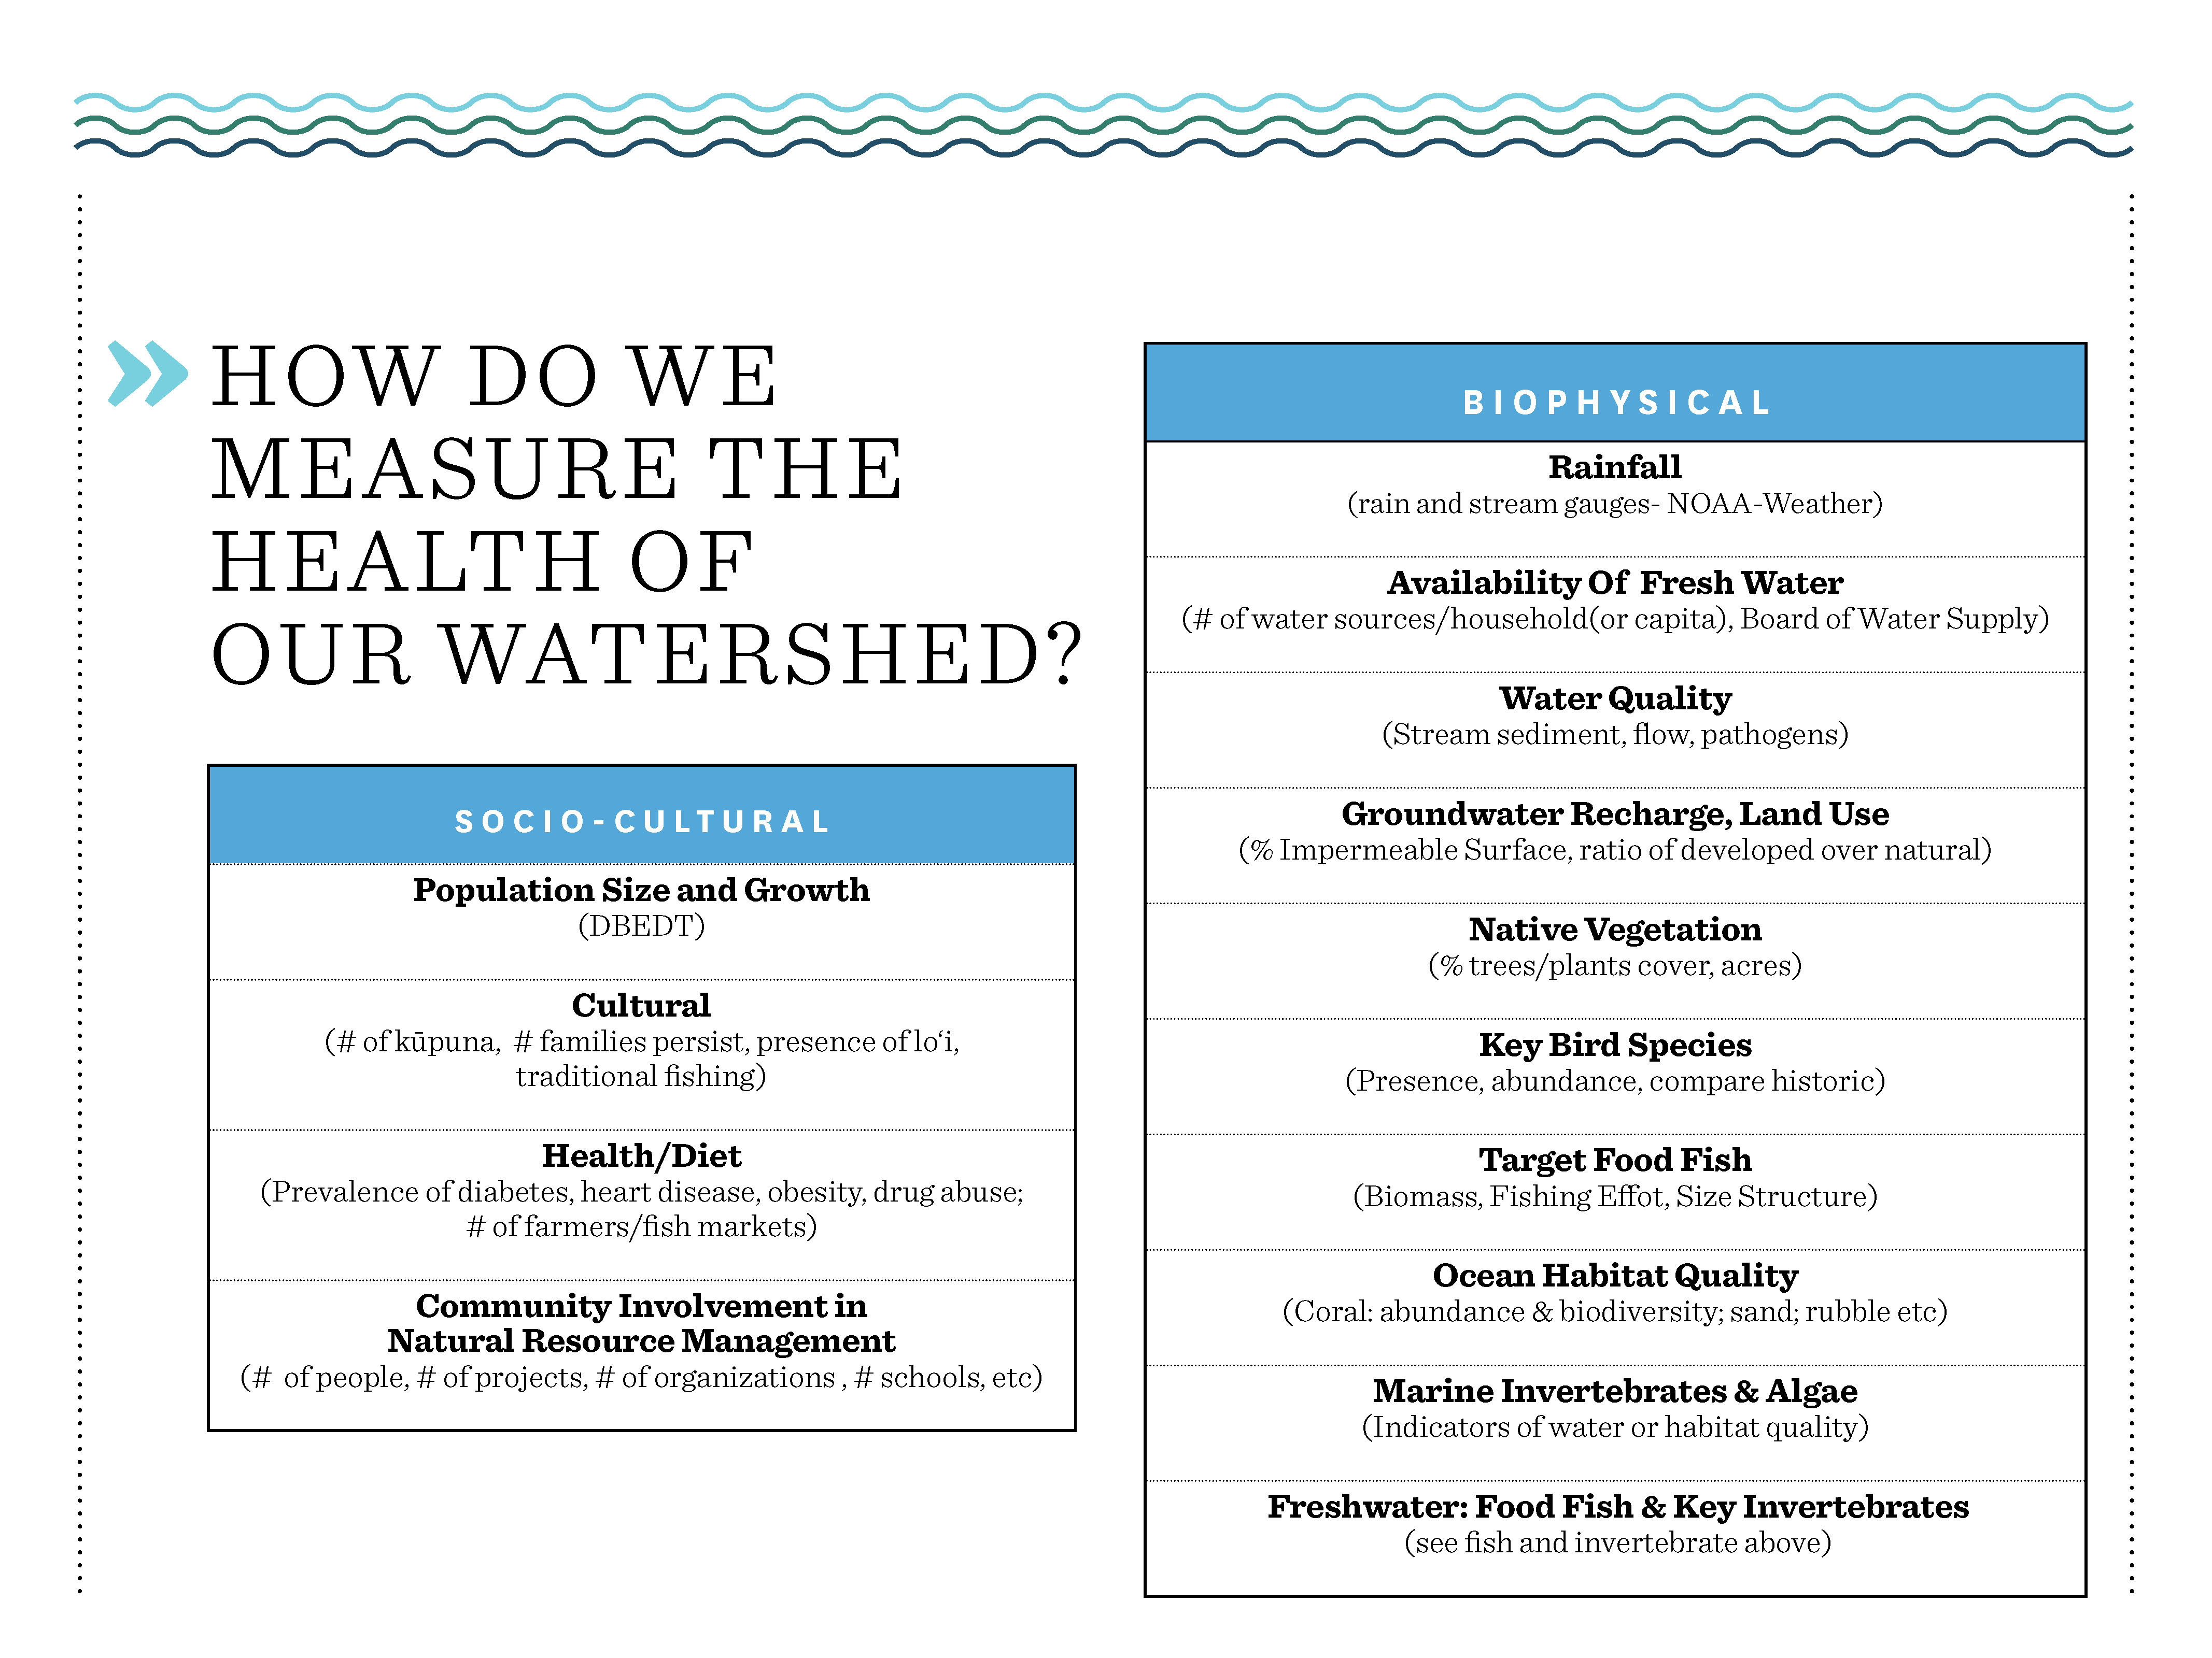
Notes:
As a result of the statewide consultation, a list of metrics was developed

Slide 6
Notes:
Place Map of Watershed Area here.

Slide 7
LIST OF
COMMUNITY MEMBERS
Notes:
List names of community members here, add pictures if space allows

Slide 8


Slide 9
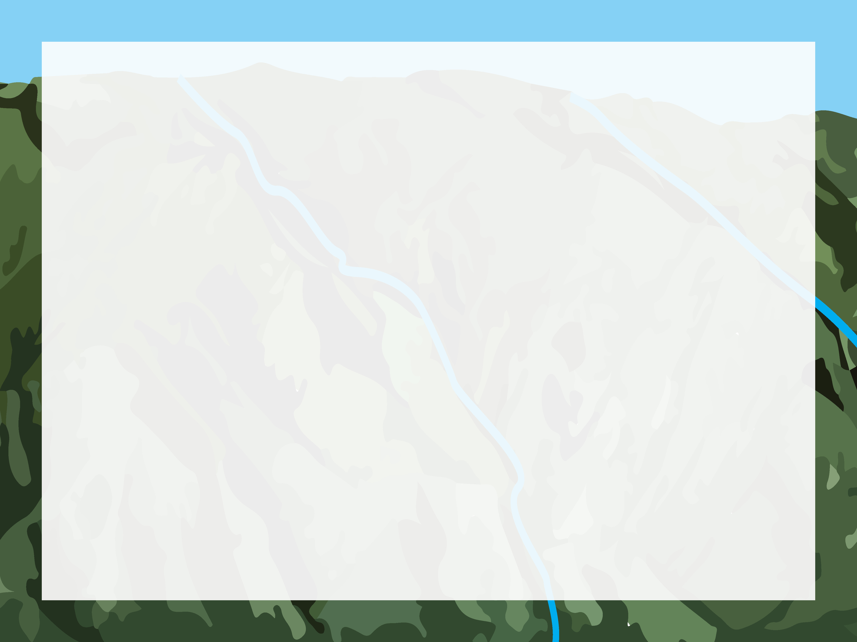
Notes:
Place Watershed Metrics from Poster and Info Graphic in this section utilizing one of these 3 backgrounds based on topic. It’s more impactful to use 1 slide per metric.

Slide 10

Notes:
Place Watershed Metrics from Poster and Info Graphic in this section utilizing one of these 3 backgrounds based on topic. It’s more impactful to use 1 slide per metric.

Slide 11

Notes:
Place Watershed Metrics from Poster and Info Graphic in this section utilizing one of these 3 backgrounds based on topic. It’s more impactful to use 1 slide per metric.

Slide 12


Slide 13
Notes:
Place image of Poster here

Slide 14
Notes:
Place image of Info Graphic and Fact Sheet here

Slide 15
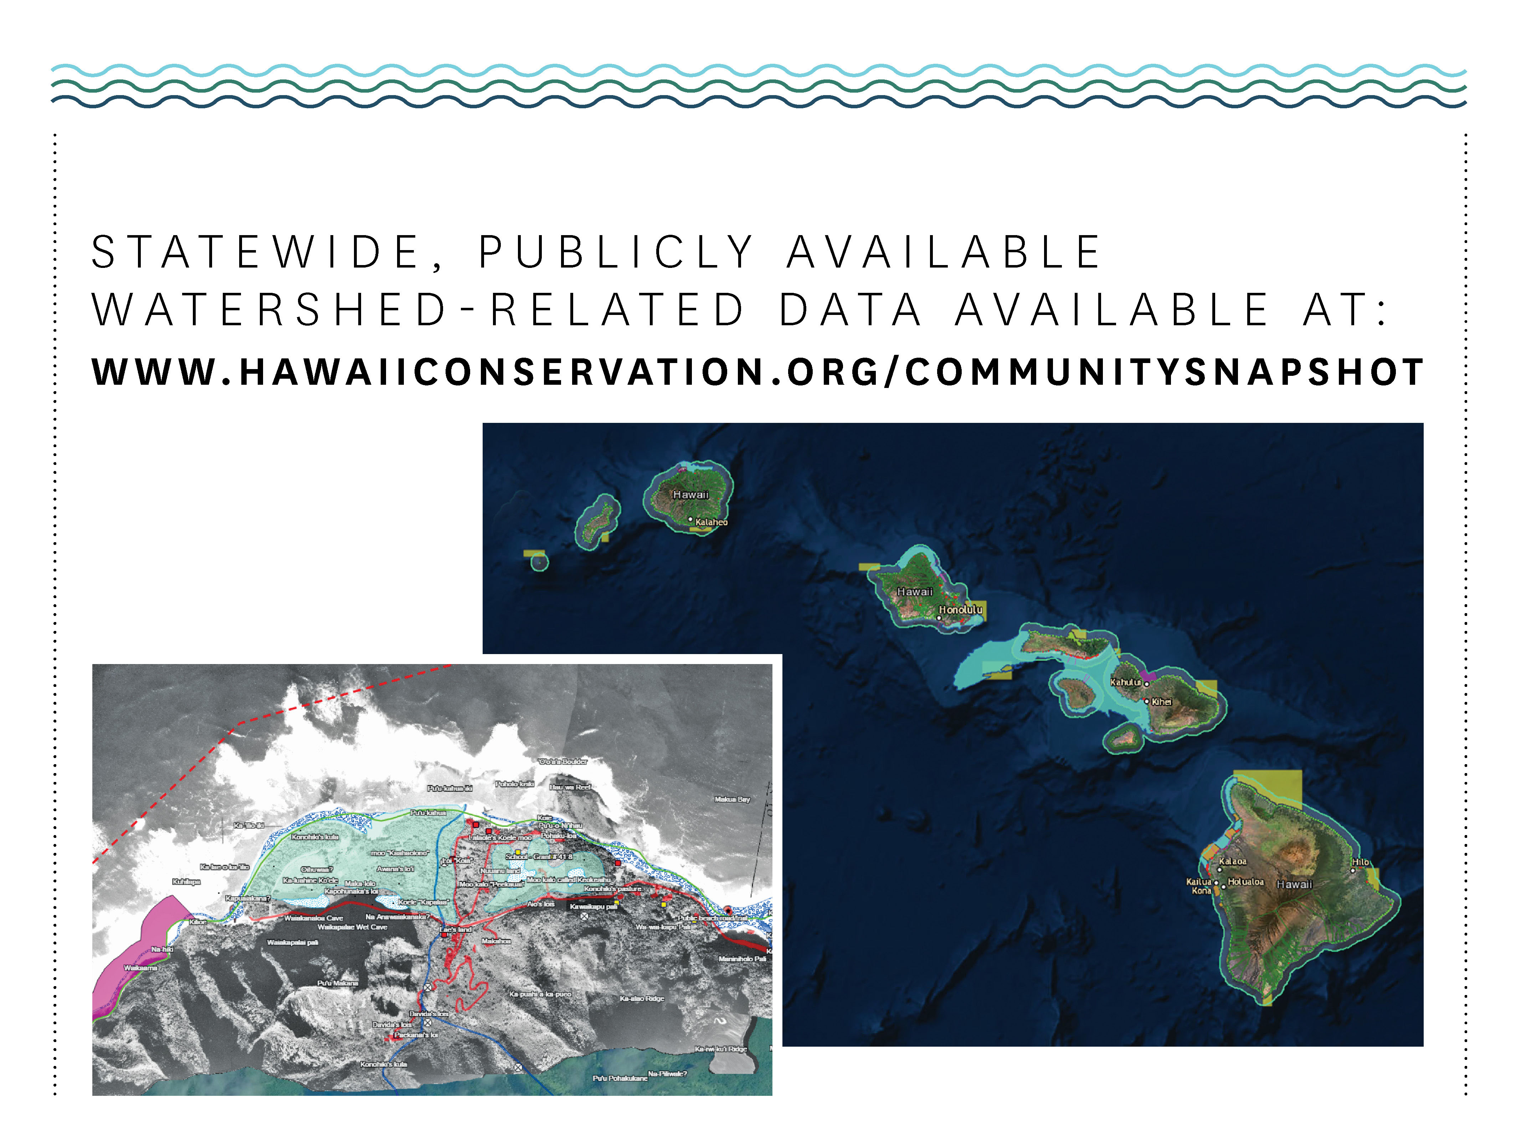

Slide 16
Mahalo
Notes:
Place logos here, if necessary

Slide 17
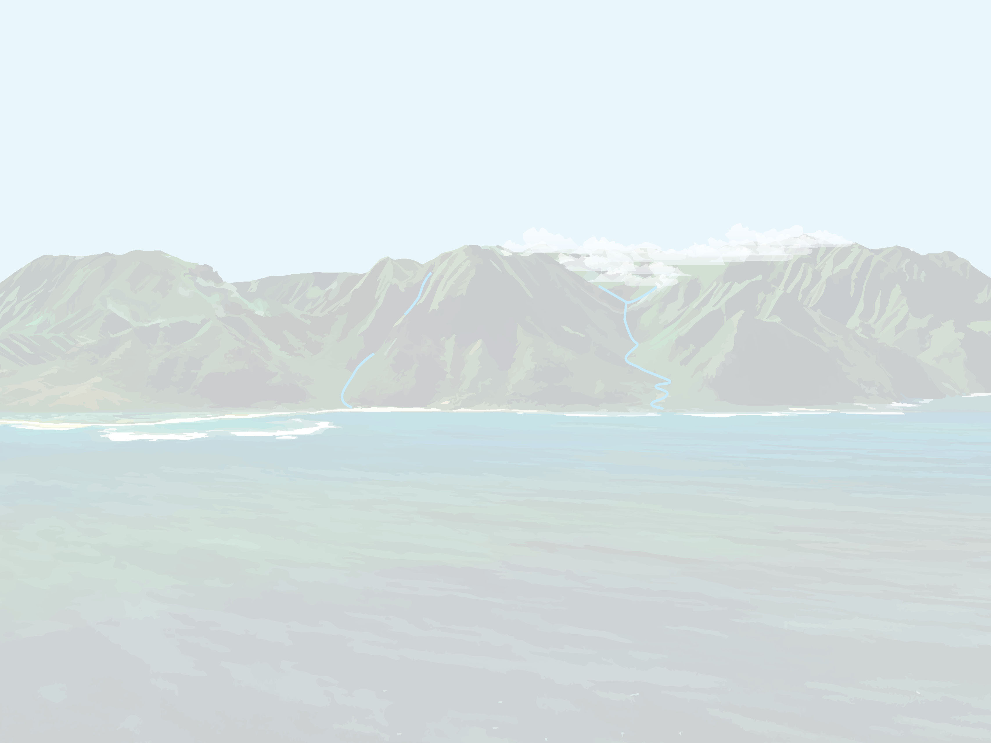
DISCUSSION

